Slide 1
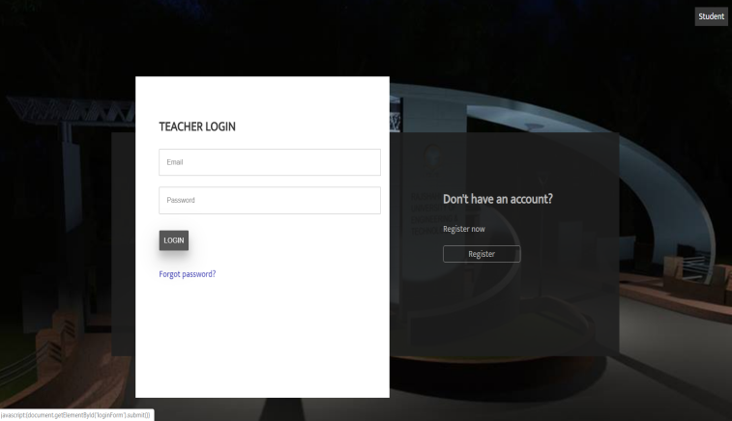
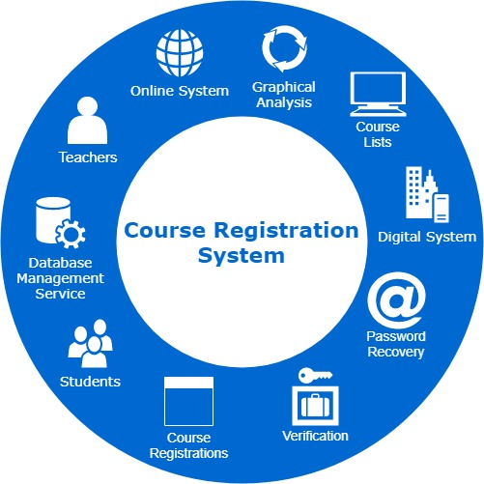
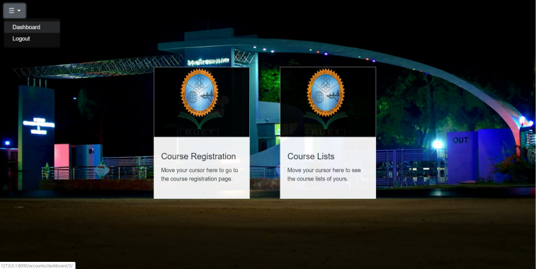
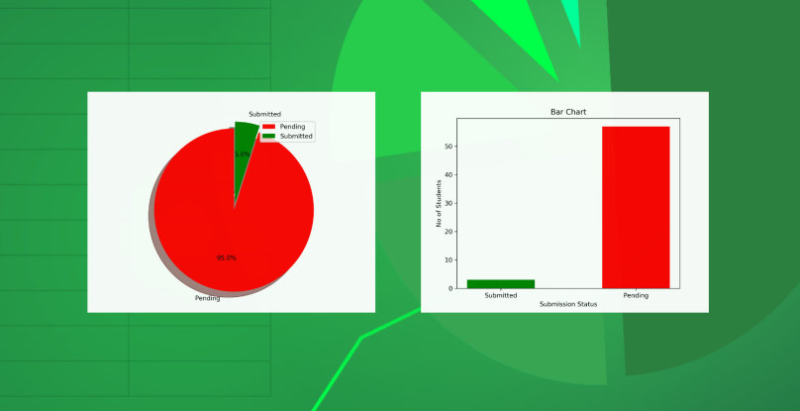
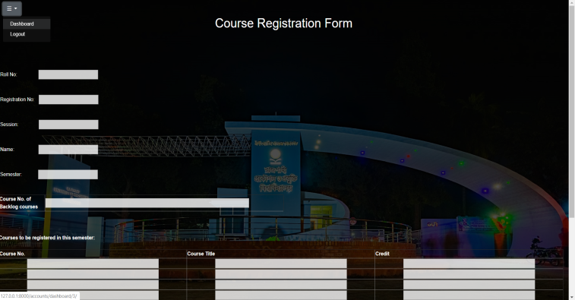
Course Registration System
Features and Interface of the Website
Students and Teachers can signup using their own information through a verification system.
After login students can select semester and complete the corresponding course registration form. They can also see the course lists of the semester.
After login teachers can view the registration forms submitted for a semester and verify them. They can also observe real-time graphical view (bar chart, pie chart) of the submissions of a class.
Student & Teacher both can apply for new password if they forget password. Applications will be verified through E-mail verification system. In summary, the whole course registration process will be performed much more efficiently than before.
What is Course Registration System?
An online system in which students can complete the
whole course registration procedures through a website.
Equipment used for the project
Operating System (Windows 10)
Visual Studio Code as Editor
Django 2.0.2 as Web Framework
Postgresql for using Database
Python, HTML, CSS, JavaScript etc as the
programming languages for Coding and designing stuff.
Risal Shahriar Shefin

